Slide 1
Rebuilding workplace substance use policy using a harm reduction lens
Byron Wood BA BN
Corey Ranger RN BN
Charlotte Ross RN RPN PhD
Katrina Stephenson RN BN
Notes:
Slide 1-4: 2 minutes

Slide 2
Land acknowledgement
We do work with individuals and organizations across all of Turtle Island and honour the lifeforce of Indigenous Peoples who have had their land stolen and who continue to resist ongoing genocide. Addressing the root causes of the toxic drug supply is deeply connected to decolonization.
Notes:
Tali

Slide 3
Acknowledgement of Lived/Living Experience
The content discussed today is made possible by people with lived/living experience of drug use sharing their knowledge and experience. Without their generosity, vital life-saving harm reduction initiatives would not exist.

Slide 4
Agenda
Solidarity and Collaboration
Byron Wood: Rethinking Substance Use Policy
Corey Ranger: Whose Safety?
Charlotte Ross: Research findings on regulatory programs for Nurses’ SUDs
Katrina Stephenson: Nurse 2 Nurse Peer Support
Charlotte Ross: Recommendations and conclusion

Slide 5
Solidarity and Collaboration
Notes:
Byron and Katrina: 6 minutes

Slide 6
Rethinking Workplace Substance Use Policy
Unceded traditional territories of the xʷməθkʷəýəm (Musqueam Indian Band), Skwxwú7mesh (Squamish Nation), and səlilwətaɬ (Tsleil-Waututh Nation).
WESUP 2024
Notes:
Byron: 12 minutes

Slide 7
Stated Goal:
To prevent workers from being impaired by substance use in the workplace
1
Supporting workers through a process of treatment and return to work
2

Slide 8
The Program:
Identify
Mandated Treatment
Abstinence
Coerced (employment & license consequences)
One size fits all regardless of whether substance use impacted the workplace
IME
SUD
Remove from work
“Independent medical exam”
Not treating/chosen physician
Residential facility
Abstinence, 12-step (AA)
All substances 24/7
Deprescribing
Drug Testing
Compliance Monitoring
Workplace Contract
Random urine screening
Medical monitoring company
2-3+ years

Slide 9
Preventing impairment at work
There is no credible research literature to suggest that there is a strong or causal relationship between employees diagnosed with Substance Use Disorder and adverse workplace outcomes.
-Chapnick, J. (2014). Beyond the label: Rethinking workplace substance use policies. Paper presented to the Human Rights Conference, Continuing Legal Education Society of British Columbia, Nov 20, 2014, Vancouver, Canada.

Slide 10
…Preventing impairment at work
A positive drug test provides no information as to when an illicit substance was used, how often or how much is typically used, or if the person was or ever has been impaired at work.
-Michael R. Frone, Alcohol and Illicit Drug use in the Workforce and Workplace (Washington, DC: American Psychological Association. 2013.)
We cannot conclude that random alcohol and drug testing is generally effective (as a deterrent to employee drug use).
-Random drug and alcohol testing for preventing injury in workers (Review- Cochrane Library, 2020)

Slide 11
Supporting Workers
Quality healthcare is:
Patient centred (informed consent, choice, control)
Specific to individual clinical needs
Respectful of patients needs and values
Evidence based -BC Ministry of Health

Slide 12
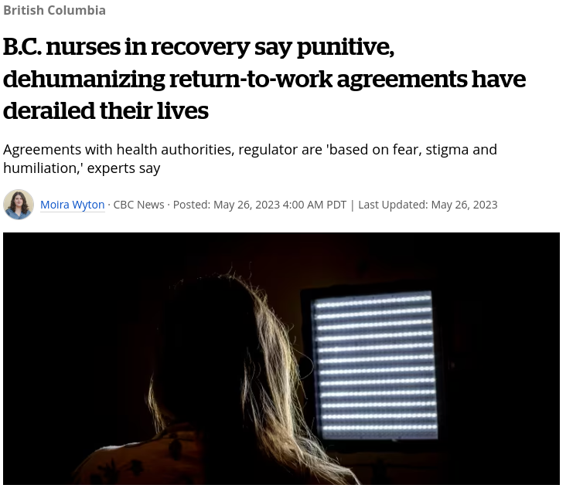
Supporting Workers
2019-2023:
78 nurses entered into agreements
60 additional nurses didn’t renew their licenses

Slide 13
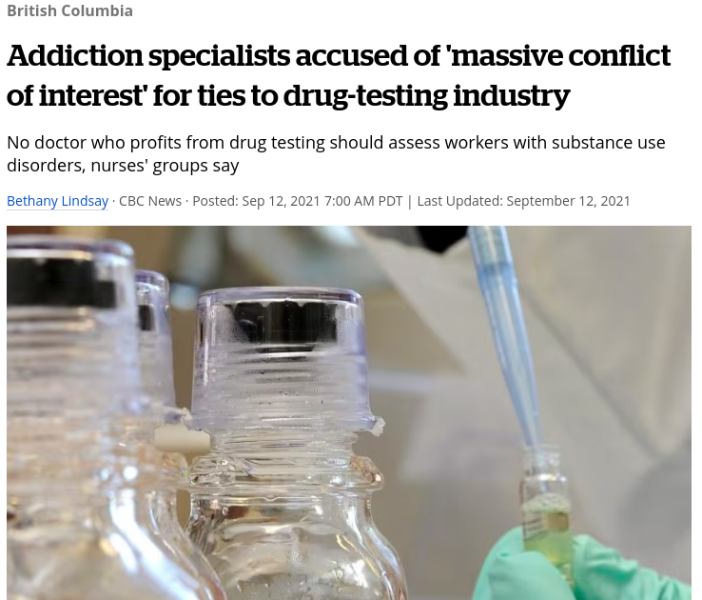
The Business of Recovery $$
Even extremely modest incentives for physicians can have a dramatic impact on the medical care that they recommend, including harmful and unnecessary interventions
-U.S. Institute of Medicine: Report on Conflict of Interest

Slide 14
References
Beyond the Label: Rethinking Workplace Substance Use Policy (2014). Chapnick, J.
Test Em’ All: Drug Testing Law and Policy (2016). Chapnick, J.
The Business of Managing Nurses Substance Use (2019). Ross, Dr. C.

Slide 15
Whose Safety?
Corey Ranger RN BN
Harm Reduction Nurses Association
Notes:
Good afternoon everyone, my name is Corey Ranger. I use he/him pronouns and I am joining today from the unceded territory of the Quw’utsun Tribe, in what is colonially referred to as Duncan. I’m joining you today in my role as president of the harm reduction nurses association. For those of you who don’t know us, the HRNA is a Canadian national organization with a mission to advance harm reduction nursing through practice, education, research and advocacy. One cool thing we’ve done recently at the HRNA is we’ve launched a harm reduction nursing scholarship, the HRNA Chapman Harm Reduction Award will help support harm reduction nurses to complete a Canadian accredited graduated program. We’re cool, check us out.
But why I am here today? Well as a part of this quartet, I’m here to ask an important question, whose safety? When we look at these programs with a critical lens we need to know who are the victims and benefactors, what does the evidence tell us? What about the experiences of those who have survived this intervention? If these programs are, as Byron articulated, to prevent workplace impairment, support access to treatment, and bring workers back to work healthy, are they actually doing that? We will talk about these two goals, we will accept the assumptions within those goals, and we will test their validity. All in nine minutes or less.

Slide 16
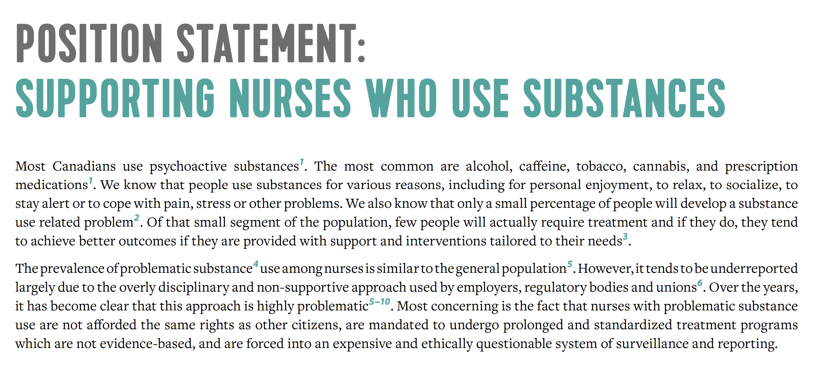
Notes:
Why is HRNA here? Pshh why are you here? Just kidding…
In 2020 we wrote a position statement on nurses who use substances, and unfortunately these words still ring true today:

Slide 17
Involuntary Care
Working definition:
Involuntary care has many faces. It includes any coercive practice that forces treatment compliance on another. That could in the form of drug treatment courts (DTC), incarceration, involuntary hospitalization, forced abstinence, or the incentivization of substance use treatment.
Context: Substance use + frontline policy
Notes:
I’ve been a harm reduction nurse for 11 years now, and I have extensive experience working with people who have been subjected to involuntary or coercive treatment, hearing their experiences, doing outreach trying to find them after they were discharged early, back out into homelessness. I’m about midway through my masters, and my focus thus far has been on misinformation, disinformation, moral panic and their influences on drug policy; that has included a significant review of the literature on involuntary care. In that research, I use the following working definition…
Considering power dynamics is important, for example, the illusion of choice provided when one’s job is on the line.

Slide 18
What is the problem represented to be?
What’s the ‘problem’ (for example, of ‘problem gamblers’, ‘drug use/abuse’, ‘gender inequality’, ‘domestic violence’, ‘global warming’, ‘sexual harassment’, etc.) represented to be in a specific policy or policy proposal?
What presuppositions or assumptions underpin this representation of the ‘problem’?
How has this representation of the ‘problem’ come about?
What is left unproblematic in this problem representation? Where are the silences? Can the ‘problem’ be thought about differently?
What effects are produced by this representation of the ‘problem’?
How/where has this representation of the ‘problem’ been produced, disseminated and defended? How has it been (or could it be) questioned, disrupted and replaced?
(Bacchi, 2012, p. 21)
Notes:
“discerning how the ‘problem’ is represented within them [policies] and to subject this problem representation to critical scrutiny” (p. 21).
I employ Carol Bacchi’s WPR approach when examining proposed substance use policy and programming. The WPR approach allows us to look critically at supposed solutions to discern our understanding of the problem. For example, when a politician proposes involuntary drug treatment as a solution to the drug poisoning emergency, they are telling us, defining our understanding of that emergency, to be one of addiction and capacity. Indeed when we accept involuntary care as a frontline policy option we are agreeing to the narratives that people who use drugs are a danger to themselves or others and they are incapable of making good decisions for themselves. The public can latch on to these framings, especially when politicians attach words like ‘compassionate’ ‘dignified’ ‘responsible’.

Slide 19
Testing Assumptions
Moral/criminal, medical, human rights framing
Social constructionism and power
Nurses’ Health Programs promote nurses’ health AND the safety of patients
“Nurses who use drugs = nurses with a SUD”
“Nurses with a SUD = workplace impairment”
Drug use is inherently problematic and must be treated
“Abstinence = safety”
Notes:
We know that substance use and addiction in Canada, both historically and presently, has been predominantly viewed as either a criminal (e.g., moralistic) or a medical issue (Boyd, Carter, & MacPherson, 2016). Therefore, much of our drug policy aims to control or stop substance use altogether.
I argue that our current approach to managing and supporting nurses who use substances is a misrepresentation, a social construct, situated within a dominant and paternalistic narrative that these nurses are a danger to themselves or others.
Through accepting programs like the Nurses Health Programs at face value, the problem representation is addiction and public or patient safety, therefore the viable solution becomes coercive treatment. Right? Those stated goals: preventing workplace impairment and connecting to treatment. And the assumptions that underpin this representation is that nurses who happen to use drugs are a risk to themselves or others, AND that they can’t be trusted to make decisions on the basis of their own health and safety, which gives way to a medical/criminal approach.
In accepting this program as the solution, we also endorse the narratives that
nurses who use drugs are nurses with a substance use disorder
nurses with a substance use disorder are nurses who are impaired in the workplace
that drug use (primarily illicit drug use) is inherently problematic and must be treated,
and that the way to guarantee safety is through abstinence.
So let’s test these assumptions. Let’s accept the narratives. Against every moral fiber, let’s say sure, that’s the problem we’re trying to address. Do these programs achieve their stated goals?

Slide 20
Evidence on Involuntary Care
Nakhaee et al., (2024) found that court-mandated treatment in Iran resulted in a 96.4% relapse rate “within the first two months after discharge” (p. 2).
Systematic review from Werb et al., (2016) reveal that the current body of evidence on involuntary treatment demonstrates both a lack of benefits and a significant potential for harm.
Ledberg and Reitan (2022) found that “the risk of dying after discharge from compulsory care for substance abuse is high” (p. 1)
“Existing evidence suggests that mandatory addiction treatment does not lead to significant improvements in substance use outcomes and can be destabilizing, increasing the risk of subsequent overdose” (Pilarinos, Kendall, Fast, & DeBeck, 2018, p. E1219)
Notes:
Nakhaee, N., Karamouzian, M., Sharifi, H., Malakshahi, K., Moaddeb, K.A., Vahidzadeh, A., & Iranpour, A. (2024). The effectiveness of court-mandated compulsory treatment in promoting abstinence among people with substance use disorders in Iran. International Journal of Drug Policy, 124, 1-4. https://doi.org/10.1016/j.drugpo.2024.104325
“1,083 adult male PWUD with a diagnosis of substance use disorders” (p. 1).
Werb, D., Kamarulzaman, A., Meacham, M.C., Rafful, C., Fischer, B., Strathdee, S.A., & Wood, E. (2015). The effectiveness of compulsory drug treatment: A systematic review. International Journal of Drug Policy, 28, 1-9. https://doi.org/10.1016/j.drugpo.2015.12.005
Systematic review of nine quantitative studies.
Ledberg, A., & Reitan, T. (2022). Increased risk of death immediately after discharge from compulsory care for substance abuse. Drug and Alcohol Dependence, 236, 1-7. https://doi.org/10.1016/j.drugalcdep.2022.109492
17 years and nearly 8,000 individuals dischared from a six month compulsory care period.
Even former BC PHO Perry Kendall has commented on the matter, alongside colleagues in a publication that states:
Testing does not test impairment, it tests compliance
People ARE able to function in their jobs while being on evidence based treatment like methadone and suboxone
Punitive programs promote covert use, preventing people seeking out support
Many people who use drugs do so episodically, recreationally, and do not venture into problematic use. Indeed, many nurses who use drugs do not qualify for a diagnosis of substance use disorder, nor are they inherently bad or evil because of their relationship with substances.
Programs that are resistant to options like OAT, are in essence anti-science. Much of BC’s public and private treatment industry is unregulated; and whether we are talking about drugs or drug treatment, a lack of regulation poses risk for harm.

Slide 21
But they say it’s working?
Notes:
For whom? Employers and independent medical examiners raking profit from a seemingly privatized monopoly?
As Cicero says, Cui bono? Who benefits? We should examine solutions from the perspectives of victims and benefactors.
We also must ask ourselves how is this being evaluated? Is it being evaluated? What are your metrics for success?
Because the bitter irony in all this, is that these programs are called things like “nurses health program”, much the same as some provinces are calling their involuntary care legislation compassionate or dignified. They’re framing their solutions as if the person of focus, in this case the nurse, is being taken care of by this initiative. But their voices are not represented in these programs, nor is the evidence, nor is the means to even track outcomes. So what it really is, is a pipeline to remove liability and perceived risk from employers. If this was about nurses health, we’d hear a lot more about nurses coming back to the workforce feeling supportive, healthy, and functional.

Slide 22
References
Bacchi, C. (2012). Introducing the ‘What’s the Problem Represented to be?’ approach. In A. Bletsas & C. Beasley (Eds.), Engaging with Carol Bacchi: Strategic Interventions and Exchanges (pp. 21–24). University of Adelaide Press.
Boyd, S., Carter, C.I., & MacPherson, D. (2016). More Harm Than Good: Drug Policy in Canada. Fernwood Publishing. Drug Treatment Courts, in Chapter 8: Services and supports for people who use drugs. pp-95-96.
Heimer, R., Black, A.C., Lin, H., Grau, L.E., Fiellin, D.A., Howell, B.A., Hawk, K., D’Onofrio, G., & Becker, W.C. (2024). Receipt of opioid use disorder treatments prior to fatal overdoses and comparison to no treatment in Connecticut, 2016-17. Drug and Alcohol Dependence, 254, pp. 1-7. https://doi.org/10.1016/j.drugalcdep.2023.111040
Ledberg, A., & Reitan, T. (2022). Increased risk of death immediately after discharge from compulsory care for substance abuse. Drug and Alcohol Dependence, 236, 1-7. https://doi.org/10.1016/j.drugalcdep.2022.109492
Nakhaee, N., Karamouzian, M., Sharifi, H., Malakshahi, K., Moaddeb, K.A., Vahidzadeh, A., & Iranpour, A. (2024). The effectiveness of court-mandated compulsory treatment in promoting abstinence among people with substance use disorders in Iran. International Journal of Drug Policy, 124, 1-4. https://doi.org/10.1016/j.drugpo.2024.104325
Werb, D., Kamarulzaman, A., Meacham, M.C., Rafful, C., Fischer, B., Strathdee, S.A., & Wood, E. (2015). The effectiveness of compulsory drug treatment: A systematic review. International Journal of Drug Policy, 28, 1-9. https://doi.org/10.1016/j.drugpo.2015.12.005

Slide 23
Research findings on regulatory programs for nurses’ SUDs
Charlotte ross RN RPN PhD
November 21, 2024
from the unceded traditional territories of the Coast Salish Peoples of the QayQayt and Kwikwetlem First Nations.
Notes:
Charlotte: 10 minutes

Slide 24
Historical Basis of ATD Treatment Programs
The standardized treatment regimes within the Alternative to Discipline (ATD) programs were established in the 1980s
Reflect understandings of SUDs and treatment from that era (abstinence/12-Step)
Have not evolved to reflect current evidence and norms of practice since that time

Slide 25
Evidence basis for The Standardized Treatment Regime
Canadian ATD programs are based on USA’s guidelines for ADT treatment programs (NCSBN, 2011), which were based on Physicians’ Health Programs (PHPs), and considered ‘best practices’ even though:
that very document states that no “verified best practice standards” (NCSBN, 2011, p.20) have ever been established for nurses’ treatment programs
many studies have found the PHPs programs and the research studies used to support them to be seriously flawed

Slide 26
What constitutes ‘success’ in evaluations of the standardized treatment program?
The metric used for Program ‘success’ in the literature has always been completion of contracts
A circular logic whereby the program essentially declares itself as a success as a beginning point, which is not a sound method of policy/program evaluation
Compliance with a coercive policy is equated with treatment success
Conformity to historical convention has now come to be regarded as evidence and best practice
No comprehensive outcome studies
On overall effectiveness for nurses’ recovery or for public safety
Comparing this treatment regime to any other treatment modalities
No data on dropouts or death

Slide 27
Standards of Care in The Program
Forced absence of evidence-based pharmacotherapies for SUDs and/or forced discontinuation of pre-existing psychiatric medications increases risk for OD, death, psych decompensation [which are not tracked]
Pre-existing mental health conditions are not addressed, within the structure of the Program, even if MH was the presenting issue

Slide 28
Standards of Care in The Program
Nurses clearly articulated that they were denied established standards of care that they were expected to adhere to in their practices:
harm reduction
trauma-informed
individualized, client-centered
fully informed and voluntary consent
collaborative treatment planning

Slide 29
Extreme power imbalances
Participants expressed extreme fear of voicing dissent [seen as not ‘engaged,’ or non-compliant], in fear of extension of contracts, loss of license, job
IMEs hold unchecked power over the nurses in the Program
‘Monitors’ – vetted and managed by the private monitoring companies: Qualifications? Oversight?

Slide 30
Corporatization and Potential Conflicts of Interest
Complete and purposeful exclusion of enrollees' existing HCPs
IMEs’ dual relationships & COIs are open knowledge, uncontested, and viewed by nursing bodies/employers as ‘not our business to police’
The Program as organized
Provides a steady revenue stream to the private businesses
Protects them from scrutiny and accountability

Slide 31
Abdication of nursing Power
Inquiry Committee members are not required to have specialized qualifications/knowledge of SUDs to adjudicate the nurses’ cases and contracts
Leaving the nursing decision-makers vulnerable to:
Decisions being guided by stereotypical understandings of SUDs, not evidence
Persuasive (and highly effective) corporate marketing strategies
Public safety mandate not upheld as impaired nurses do not obtain help out of fear and remain actively practicing

Slide 32
The state of Canadian research on nurses’ SUDs
We do not know the scope of the problem in Canada
No national prevalence data on nurses’ SUDs (one provincial study + 1 CFNU pre-pandemic survey questioning alcohol use)
Or how many nurses are/are not seeking help for SUDs
Only 2 nurse researchers in Canada have researched nurses’ SUDs

Slide 33
References
Ross, C. A. (2021). Public protection as a ruling concept in the management of nurses’ substance use. In, The Palgrave handbook of institutional ethnography. P. C. Luken & S. Vaughan (Eds.). Palgrave MacMillan.
Ross, C. A., Jakubec, S. L., Berry, N. S. & Smye, V. (2019). The business of managing nurses’ substance use. Nursing Inquiry, 2019; 00:e12324. https://doi.org/10.1111/nin.12324
Ross, C. A., Jakubec, S. L., Berry, N. S. & Smye, V. (2018). “A two glass of wine shift”: Dominant discourses and the social organization of nurses’ substance use. Global Qualitative Nursing Research. https://doi.org/10.1177/2333393618810655
Ross, C., Berry, N., Smye, V. & Goldner, E. (2017). A critical review of knowledge on nurses with problematic substance use: Moving from individual blame to awareness of structural factors. Nursing Inquiry, 2017; e12215. https://doi.org/10.1111/nin.12215

Slide 34
References
Kunyk, D. (2015). Substance use disorders among registered nurses: Prevalence, risks and perceptions in a disciplinary jurisdiction. Journal of Nursing Management, 23(1), 54–64. https://doi.org/10.1111/jonm.12081
Kunyk, D., & Austin, W. (2011). Nursing under the influence: A relational ethics perspective. Nursing Ethics, 19(3), 380–389. https://doi.org/10.1177/0969733011406767
Kunyk, D., Inness, M., Reisdorfer, E., Morris, H., & Chambers, T. (2016). Help seeking by health professionals for addiction: A mixed studies review. International Journal of Nursing Studies, 60, 200–215. https://doi.org/10.1016/j.ijnurstu.2016.05.001
Kunyk, D., Milner, M., & Overend, A. (2016). Disciplining virtue: Investigating the discourses of opioid addiction in nursing. Nursing Inquiry, 23(4), 315–326. https://doi.org/10.1111/nin.12144

Slide 35
Nurse 2 Nurse Peer Support
Katrina Stephenson RN BN
Notes:
Katrina: 5 minutes

Slide 36
Peer support focuses on health and recovery rather than illness and disability
Mental Health Commission of Canada, 2013

Slide 37
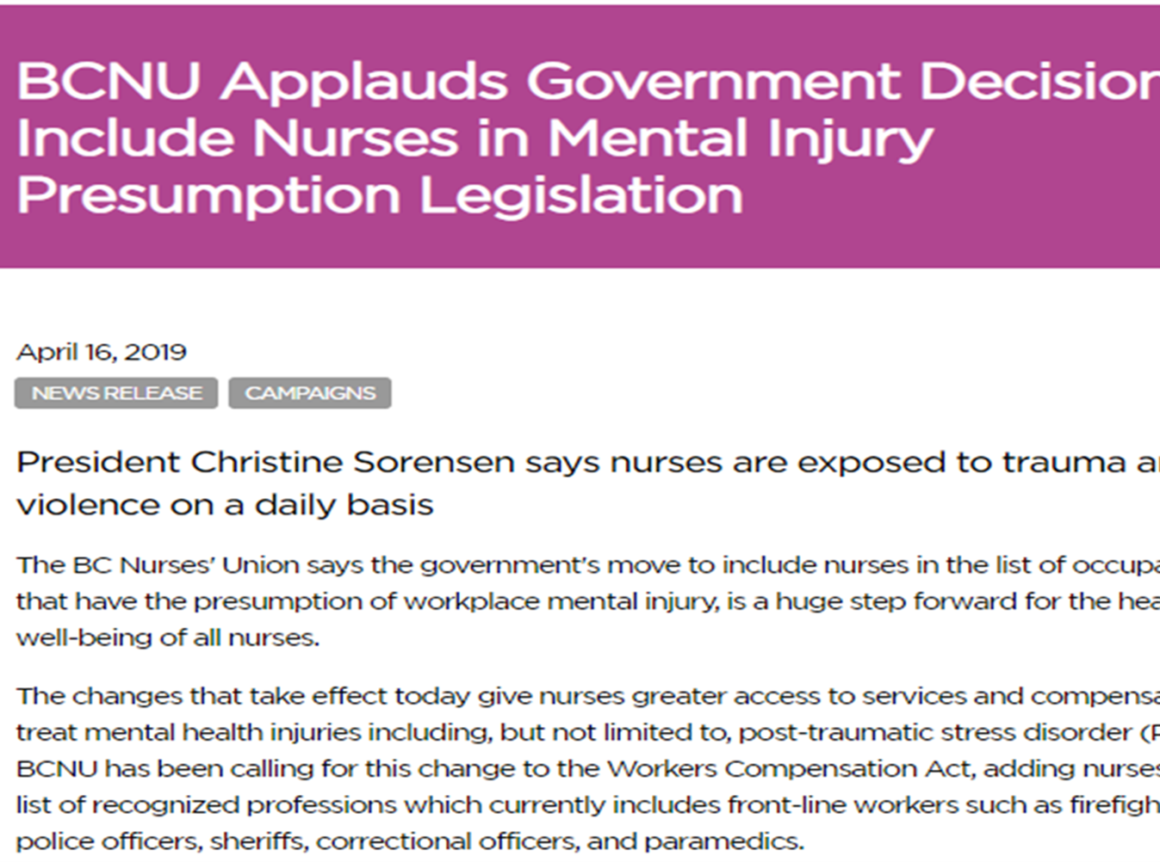

Slide 38
Types of Peer Support
not all peer support is equal
Formal
structured training process
trauma/violence informed
resources Best practice guidelines by MHCC
Informal
no requirements
no resources
no structure or guidelines
not necessarily trauma-informed

Slide 39
Nurses’ MH Injuries
Even in areas with presumptive PTSD legislation for nurses, there is no national standardized process for provision of psychological support for nurses.
Most supports available for nurses are reactive, fragmented and fail to incorporate a preventative, holistic approach (Rangachari & Woods, 2020).
Currently a 6-9 month wait for assessment for psychological injury

Slide 40
WorkSafe BC Claims for Psychological Injury 2022

Slide 41
WorkSafe BC Acceptance of Claims for Psychological Injury in 2022

Slide 42
Recommendations and Conclusion
For Changes to the Assistance & Regulatory Programs to Address Nurses’ Substance Use Challenges
Notes:
Charlotte: 5 minutes

Slide 43
1. WHOLESALE REEVALUATION AND RESTRUCTURING OF THE CURRENT APPROACH
To afford all nurses the same right to continued employment, bodily autonomy, and quality, ethical, and public-pay health care as other citizens and nurses with other health issues.
Nurses’ treatment for SU should be integrated into a comprehensive, unified process to address nurses’ health and not addressed as a separate issue

Slide 44
2. IF NO PRACTICE IMPAIRMENT
If a nurse's substance use has not impacted the workplace, it is not the place of the employer or College to intervene.
Rely on evidence rather than a theoretical diagnosis and the stereotypical misconception that all nurses who use substances necessarily present a risk of harm in the workplace
Offer pre-disability treatment resources that are evidence-based, non-intrusive, voluntary, confidential, and can be accessed through health benefit packages while remaining at work

Slide 45
3. IF PRACTICE IMPAIRMENT
Nurses whose practice is affected by substance use should be treated the same way that nurses with any other potentially impairing condition or factor would be treated:
The response to nurse impairment must be:
Proportionate
Reasonable
Informed by an assessment of risk and job performance
Offering all nurses a full menu of substance use services that are:
voluntary and non-coercive
confidential
individualized
evidence-based
harm-reduction based
can be accessed through health benefit packages
do not require 24/7 abstinence of all psychoactive substances and compliance monitoring

Slide 46
3. IF PRACTICE IMPAIRMENT (CONT’D)
Provide access to HCPs
who nurses know and trust into the process
who know nurses’ workplace realities and risks
Services should include an informed choice with a preferred provider list of HCPs who offer evidence-based, individualized, treatment approaches, including pharmacological treatments (*OATs)
Choice of qualified physician or NP

Slide 47
4. ASSESSMENT OF RISK TO NURSES
Risk assessments should also include a substantive evaluation of risks to nurses within their workplaces
as contributory to their substance use challenges
to mitigate risks to nurses on their return to work

Slide 48
5. POLICIES & PROCESSES
Treatment services should be decoupled from College and Employer regulatory processes
Address potential and actual COIs
Utilize publicly funded services
Examine how ‘expertise’ is being defined and where the experts are positioned within the processes and power structures:
Install nurses with expert knowledge for case adjudication and policy making roles (i.e., Inquiry Committees, NPs)
Consider the philosophical perspectives of potential ‘experts’ i.e., evidence-based vs ideological
Track nurses’ actual outcomes from the Program, including: those who dropped out or left nursing, deaths (ODs, suicide), which are not tracked

Slide 49
QUESTIONS AND COMMENTS?

